Slide 1






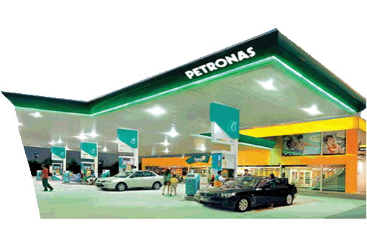



PRESENTATION OUTLINE
VENDOR ENGAGEMENT SESSION
Manage SRM Supplier Collaboration
December, 2012
Notes:
1
The presentation shall focus on 4 main areas:-
Firstly, why is there is a need for us to change. I’ll be sharing, how is our transformation journey, our approach and what are the elements that are critically required to sustain the momentum for change

Slide 2
Course Description & Objectives
Course Description:
The overall supplier self-service process is to manage the procurement related transaction between the purchaser and the supplier.

Slide 3
Course Agenda
Process Overview
Key Changes
Manage Bidder Response for RFQ 1 Tier Evaluation
Manage Bidder Response for RFQ 2 Tier Evaluation
Manage Supplier Collaboration
Manage SRM SUS Purchase Order Confirmation/Acknowledgement
Manage SRM SUS Goods Receipt/Service Confirmation
Manage SRM SUS Invoice Processing
Summary
Appendix

Slide 4
Process Overview - Manage RFQ 1–Tier and 2-Tier
(Below Threshold)
Supplier’s Response
An email notification will be generated and sent to the invited bidders. Supplier will login to SUS portal and decide whether to participate in the RFQ activity.
If a supplier decided to participate in the bid, they can proceed to Create Bid.
Non responding bidder will be disqualified. The purchaser is able to view the participation status via the Procurement portal.
Suppliers will respond to RFQ questions (if applicable) and attach supporting documents if necessary.
Participating suppliers may enter price for every single line item. Suppliers are given the option to withdraw or resubmit their bid before the closing date.
Suppliers are able to upload technical documents to the CFolder (Online Storage) for RFQ 2-Tier

Slide 5
Process Overview - Manage Supplier Collaboration
The overview of the basic business process flow is as follows:
Purchase Order is created and send to SUS Portal.
Supplier to confirm/acknowledge Purchase Order in SUS Portal.
Goods Receipt and Service Confirmation
Material Item - Goods receipt (GRN) will be sent to SUS Portal
Service Item - Supplier to create Service Confirmation in SUS Portal
Create Invoice in SUS Portal and Parked Invoice will be generated in Petronas system.
Note: ASN (Advance Shipping Notification) creation for material item is not required in this new process.

Slide 6
Course Agenda
Process Overview
Key Changes
Manage Bidder Response for RFQ 1 Tier Evaluation
Manage Bidder Response for RFQ 2 Tier Evaluation
Manage Supplier Collaboration
Manage SRM SUS Purchase Order Confirmation/Acknowledgement
Manage SRM SUS Goods Receipt/Service Confirmation
Manage SRM SUS Invoice Processing
Summary
Appendix

Slide 7
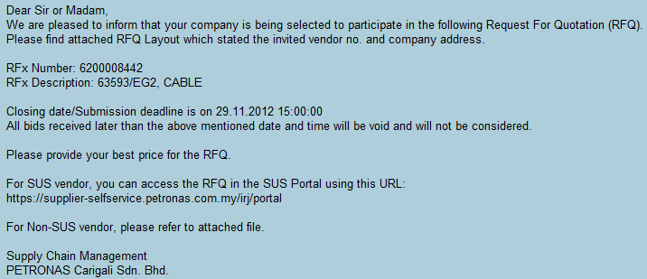

Bidder Response For RFQ 1 Tier Evaluation – Email Notification

Slide 8
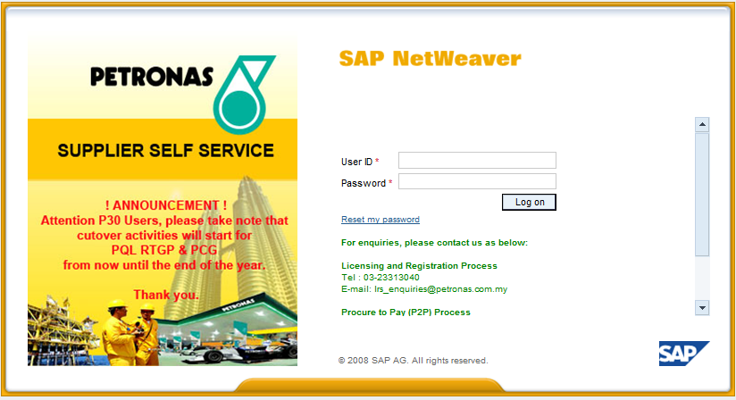
Bidder Response For RFQ 1 Tier Evaluation – Login Screen
Supplier is required to login to SUS portal
Enter User ID
Enter Password
Click “Log on”

Slide 9
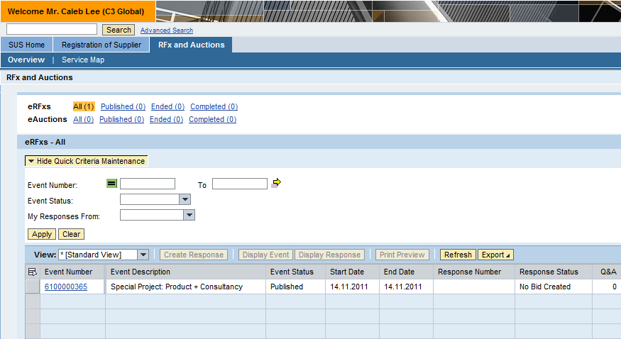
Bidder Response For RFQ 1 Tier Evaluation
NOTE: 2 ways to search for RFQ – Supplier can either click “Refresh” (refer screen shot above: step 2a) to display all RFQs (Event Number) or supplier can key in the RFQ number (refer screen shot above: step 2b(i)) and click “apply” (refer screen shot above: step 2b(ii)).
Click “RFx and Auctions” tab
2b(i). Enter “Event Number”
2a. Click “Refresh”
2b(ii). Click “Apply”
Click “Event Number”

Slide 10
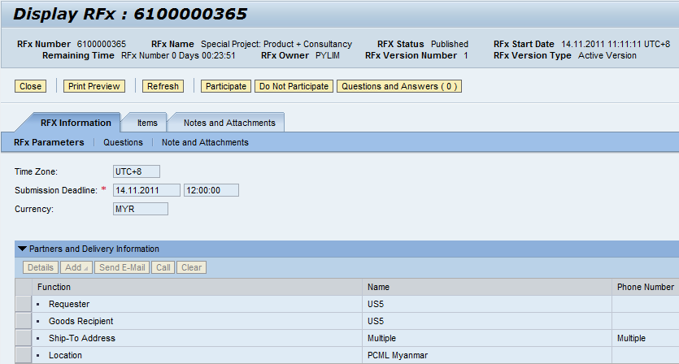
Bidder Response For RFQ 1 Tier Evaluation – Intend of Participation
NOTE: Supplier is able to view the RFQ document information by clicking on the different tabs (Refer to Screen Shot: Step 1) before deciding whether or not to participate in this RFQ activity.
Click “Participate”
Click on tabs

Slide 11
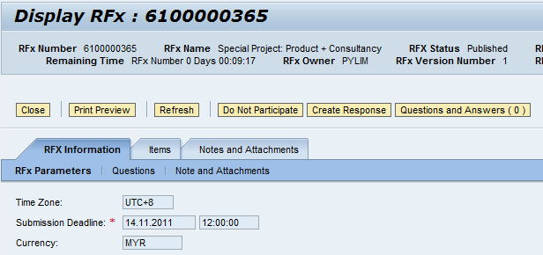
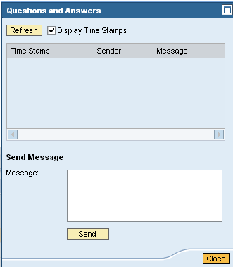
Bidder Response For RFQ 1 Tier Evaluation – Create Response
Click “Questions and Answers”
Click “Create Response” to generate/ create bid.

Slide 12
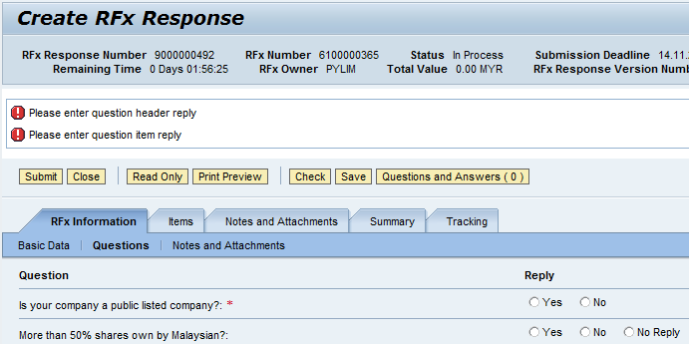
Bidder Response for RFQ 1 Tier Evaluation – Question (Header Level)
To answer all “Header Questions“ posted by Purchaser.
NOTE: Question(s) with * indicate mandatory question(s) to be answer by supplier. Supplier will not be able to submit response if mandatory question(s) is not answered.

Slide 13
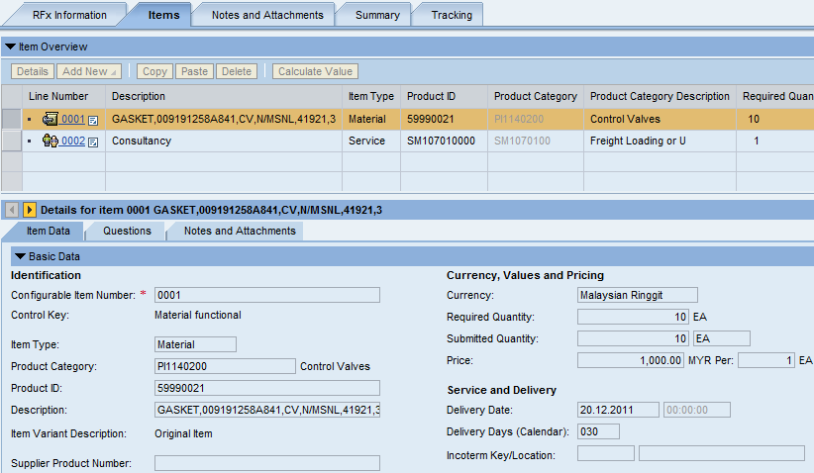
Bidder Response for RFQ 1 Tier Evaluation – Basic Data (Line Item Level)
NOTE: Delivery Days will be use as a calculation for the PO delivery date in later stage.
(PO Delivery Days = PO Creation Date + Delivery Days)
NOTE: Supplier is required to leave the “price” column blank if supplier is not able to supply the product.
Click “Detail” to display line item detail
Information: Line Item Details
Enter “Price”
Enter “Delivery Days”

Slide 14
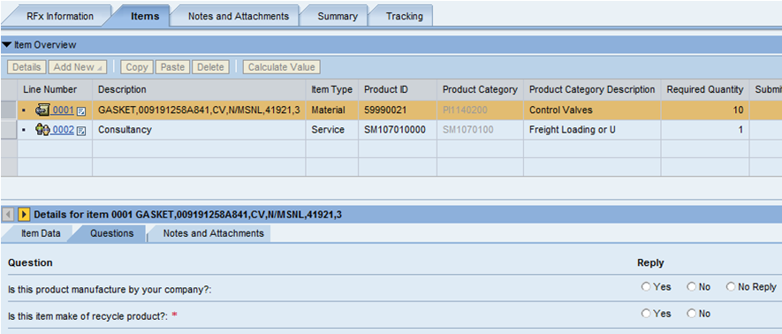
Bidder Response for RFQ 1 Tier Evaluation – Questions (Line Item Level)
To answer all “Line Item Questions“ posted by Purchaser.
NOTE: Question(s) with * indicate mandatory question(s) to be answer by supplier. Supplier will not be able to submit response if mandatory question(s) is not answered.

Slide 15
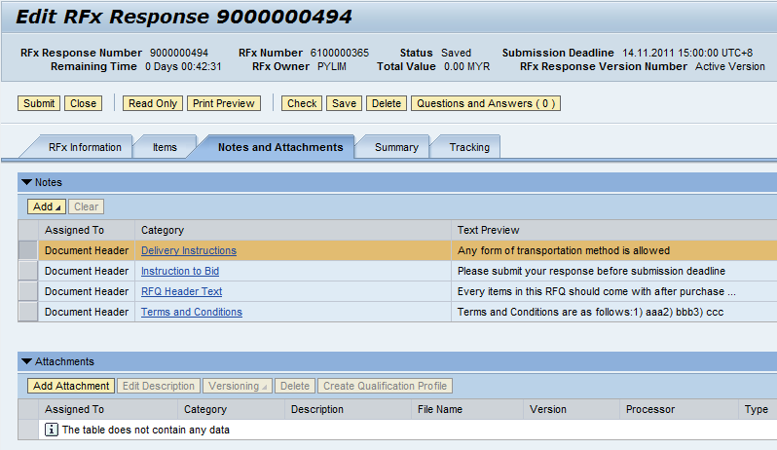
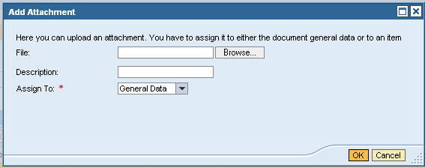
Bidder Response for RFQ 1 Tier Evaluation – Notes and Attachments
To attach file
Click “Browse” to attach file
Click “Submit”
Enter “Description”
Select ”General Data” OR “Item Data”
Click “Add Attachment”

Slide 16
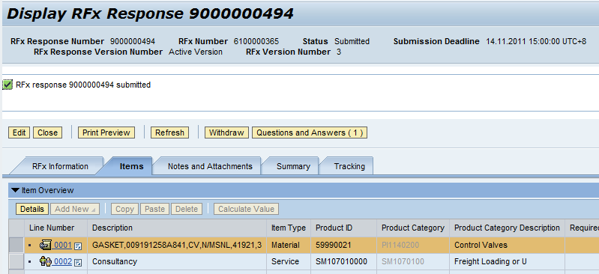
Bidder Response for RFQ 1 Tier Evaluation – Withdraw a Submitted Bid Response
In order to “withdraw” a submitted bid response, supplier is required to “edit” the bid response document first and enter the “withdraw reason”.
Click “Edit”
Information: Status changed to “Submitted”

Slide 17
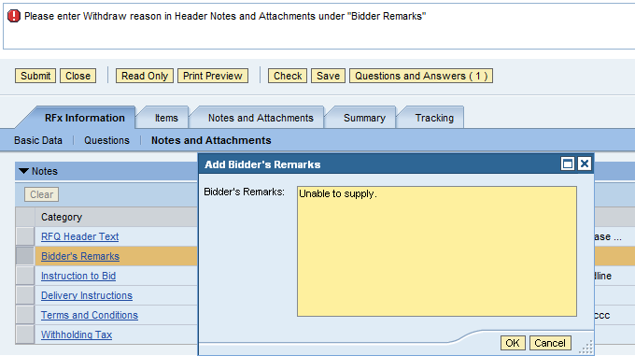
Bidder Response for RFQ 1 Tier Evaluation – Withdraw a Submitted Bid Response (Cont)
Edit Mode
Click “Submit”
Enter “Bidder’s Remark” then Click “OK”
Click “Bidder’s Remark”

Slide 18
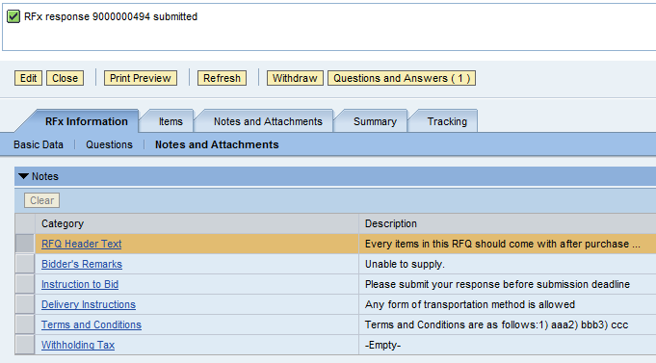
Bidder Response on RFQ 1 Tier Evaluation – Withdraw a Submitted Bid Response (Cont)
Once supplier click on “Withdraw” button, the bid response is withdraw.
Click “Withdraw”

Slide 19
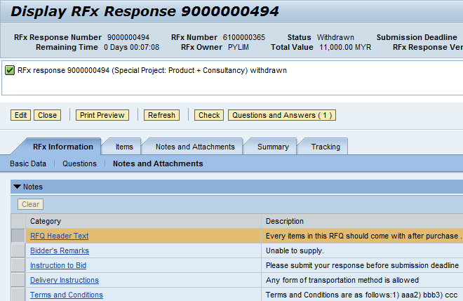
Bidder Response on RFQ 1 Tier Evaluation – Withdraw a Submitted Bid Response (Cont)
Status is “Withdrawn”. Supplier is able to resubmit bid so long it’s still within submission deadline.
Click “Edit” to resubmit bid

Slide 20
Course Agenda
Process Overview
Key Changes
Manage Bidder Response for RFQ 1 Tier Evaluation
Manage Bidder Response for RFQ 2 Tier Evaluation
Manage Supplier Collaboration
Manage SRM SUS Purchase Order Confirmation/Acknowledgement
Manage SRM SUS Goods Receipt/Service Confirmation
Manage SRM SUS Invoice Processing
Summary
Appendix

Slide 21
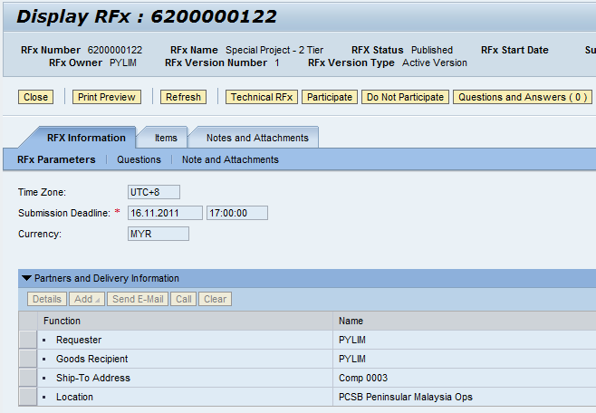
Bidder Response For RFQ 2 Tier Evaluation – Intend of Participation
NOTE: Supplier is able to view the RFQ document information by clicking on the different tabs (Refer to Screen Shot: Step 1) before deciding whether or not to participate in this RFQ activity.
Information: Click on button
Click “Participate”
Click on tabs

Slide 22
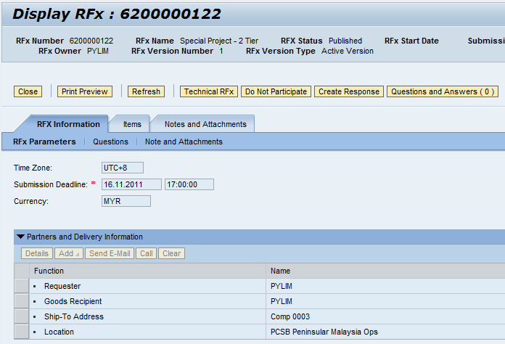
Bidder Response For RFQ 2 Tier Evaluation – Create Response
Click “Create Response” to generate/ create bid.

Slide 23
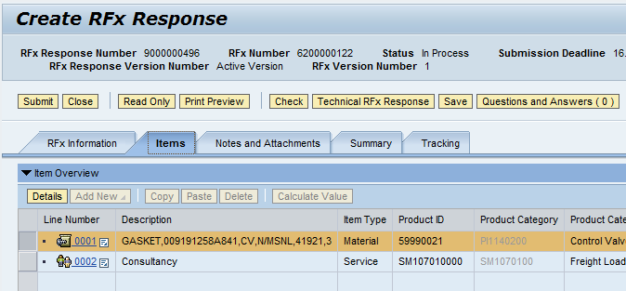
Bidder Response for RFQ 2 Tier Evaluation – Create Response (Cont)
NOTE: The rest of the bid submission steps are the same as RFQ 1 Tier Evaluation.
Click “Technical RFx Response”

Slide 24
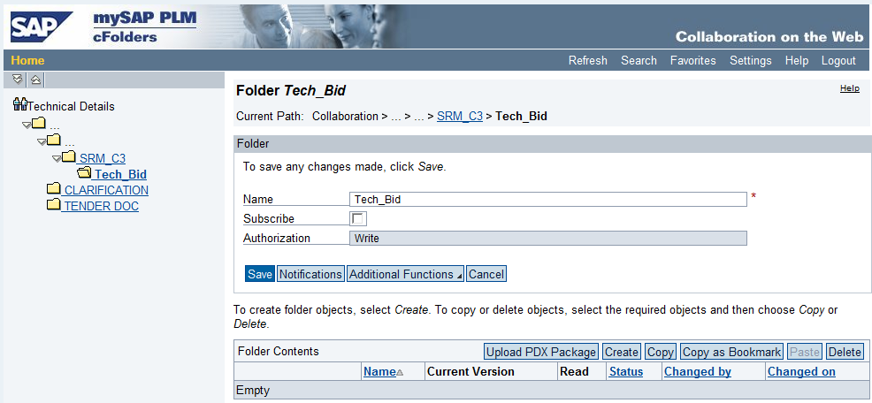
Bidder Response for RFQ 2 Tier Evaluation – Technical RFx Response
Technical Bid Folder – Enable supplier to upload technical Bid.
Clarification Folder – Enable supplier to clarify question(s) posted by purchaser.
Tender Doc Folder – Enable supplier to download technical spec. attached by purchaser to supplier’s local drive.
Tech Bid Folder
Clarification Folder
Tender Doc Folder

Slide 25
Course Agenda
Process Overview
Key Changes
Manage Bidder Response for RFQ 1 Tier Evaluation
Manage Bidder Response for RFQ 2 Tier Evaluation
Manage Supplier Collaboration
Manage SRM SUS Purchase Order Confirmation/Acknowledgement
Manage SRM SUS Goods Receipt/Service Confirmation
Manage SRM SUS Invoice Processing
Summary
Appendix

Slide 26
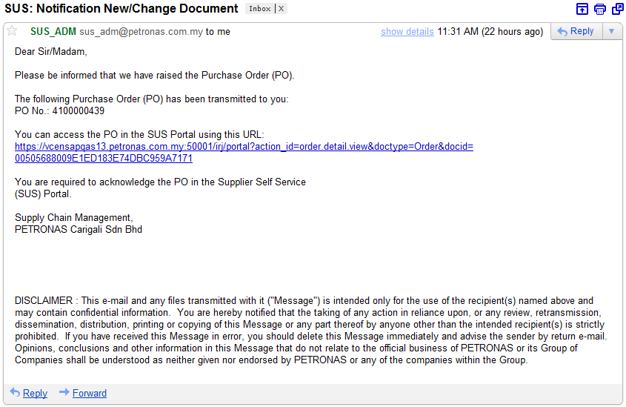
Manage Supplier Collaboration Upon Award – Email Notification

Slide 27
Manage Supplier Collaboration Upon Award – Login Screen
Supplier is required to login to SUS portal.
Enter User ID
Enter Password
Click “Log on”
Click “Log on”

Slide 28
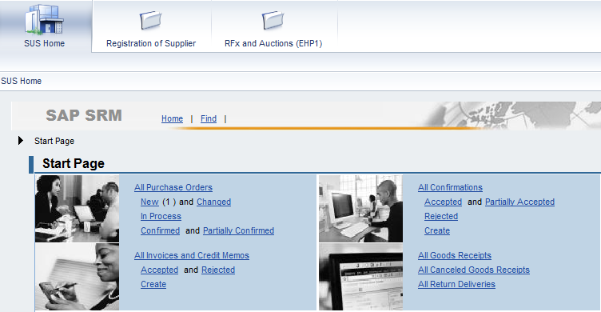
Process Overview - Manage Supplier Collaboration Upon Award
Click “SUS Home” Tab
Click “New”

Slide 29
Course Agenda
Process Overview - Manage Supplier Collaboration Upon Award
Process Details
Manage SRM Purchase Order Confirmation
Manage SRM Goods Receipt/ Service Confirmation
Manage SRM Invoice Processing
SAP Demonstration/ Exercises
SUS Manage SRM Supplier Collaboration (For Material)
SUS Manage SRM Supplier Collaboration (For Services)
Summary
Appendix

Slide 30
Process Details - Manage Purchase Order Confirmation
The Purchase Order Confirmation is also known as Purchase Order Response/ Acknowledgement in the As-Is process.
Whenever a PO is created in Petronas system, this order will be transferred to SUS automatically with “New” status.
Supplier will then post Purchase Order Confirmation in SUS Portal.

Slide 31
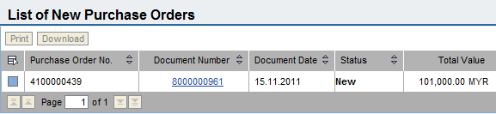
Process Details - Manage Purchase Order Confirmation (Material and Services)
Click on Document Number “8xxxxxxxxx”
Information: Status is “New”

Slide 32
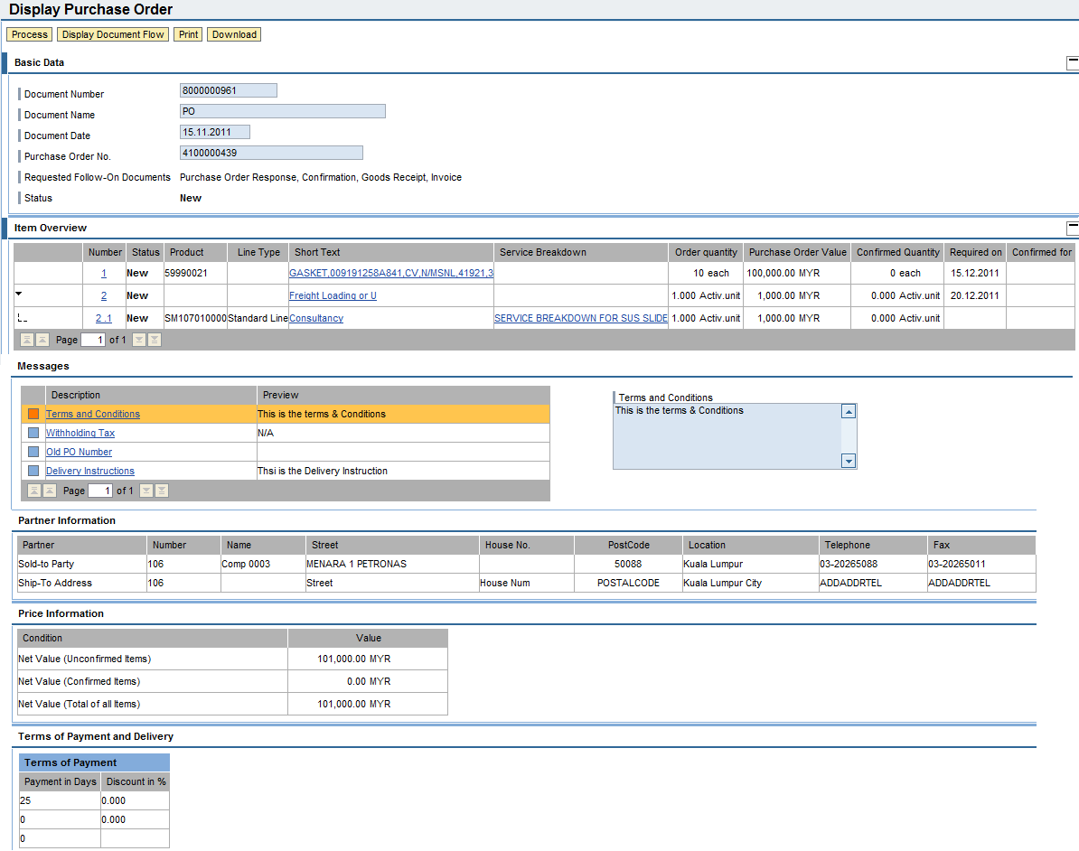
Process Details - Manage Purchase Order Confirmation (Material and Services)

Slide 33
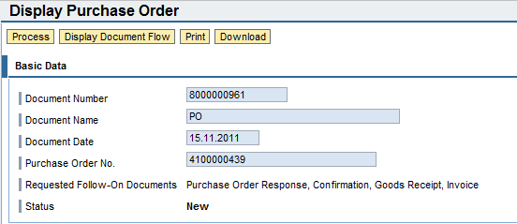
Process Details - Manage Purchase Order Confirmation (Material and Services)
Click “Process”

Slide 34
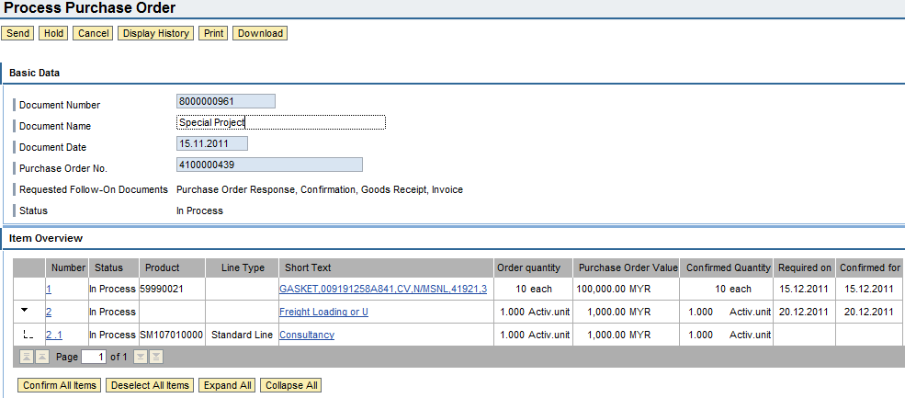
Process Details - Manage Purchase Order Confirmation (Material and Services)
Click “Send”
Enter “Document Name”
Click “Confirm All Items”

Slide 35
Course Agenda
Process Overview - Manage Supplier Collaboration Upon Award
Process Details
Manage SRM Purchase Order Confirmation
Manage SRM Goods Receipt/ Service Confirmation
Manage SRM Invoice Processing
SAP Demonstration/ Exercises
SUS Manage SRM Supplier Collaboration (For Material)
SUS Manage SRM Supplier Collaboration (For Services)
Summary
Appendix

Slide 36
Process Details - Manage SRM Goods Receipt/Service Confirmation
For Material, all goods will be inspected and good receipt (GRN) will be sent to SUS portal. Supplier is able to view the goods acceptance status in SUS portal
For Services, Supplier is required to create service confirmation in SUS portal. Service entry sheet (SES) will be generated in Petronas system
In SUS portal, supplier is able to check the status and view the document flow from PO to Goods Receipt / Service Confirmation.

Slide 37
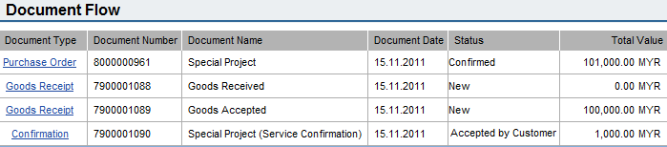
Process Details - Manage SRM Goods Receipt (GRN)
For Material Item, supplier is able to view GRN sent to SUS
Goods are received for inspection
Goods are accepted

Slide 38
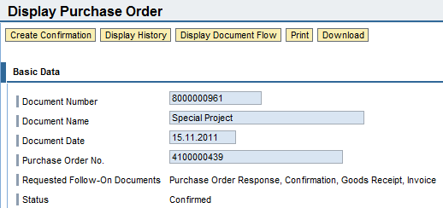
Process Details - Manage SRM Goods Receipt/ Service Confirmation (Create Service Confirmation)
For Service Item, supplier is required to create service confirmation after service is being performed.
Click “Create Confirmation”

Slide 39
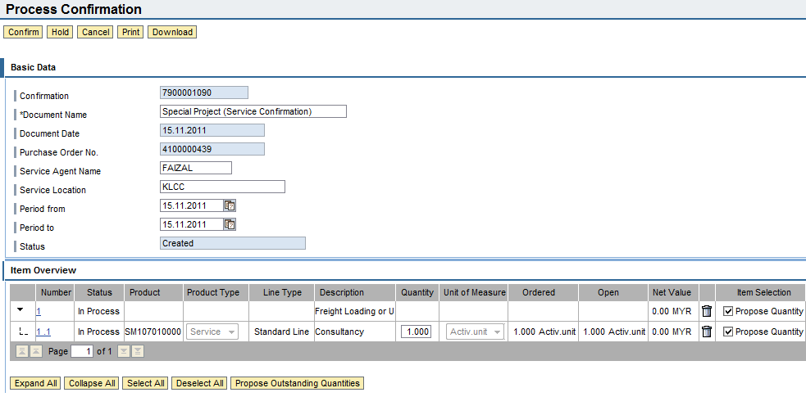
Process Details - Manage SRM Goods Receipt/ Service Confirmation (Create Service Confirmation - Cont)
Supplier is allowed to confirm partial quantity.
Click “Confirm”
Fill in required information
Click “Select All”
Click “Propose Outstanding Quantities”

Slide 40
Process Details - Manage SRM Goods Receipt (GRN)
Supplier is able to view Service Confirmation Status
Service Confirmation is accepted by Petronas

Slide 41
Course Agenda
Process Overview - Manage Supplier Collaboration Upon Award
Process Details
Manage SRM Purchase Order Confirmation
Manage SRM Goods Receipt/ Service Confirmation
Manage SRM Invoice Processing
SAP Demonstration/ Exercises
SUS Manage SRM Supplier Collaboration (For Material)
SUS Manage SRM Supplier Collaboration (For Services)
Summary
Appendix

Slide 42
Process Details - Manage SRM Invoice Processing
Supplier can proceed to create invoice for accepted goods and accepted service entry sheet (SES).
If this invoice is deleted/rejected by Petronas CAPS, email notification will be sent to supplier. Supplier is required to set the invoice status to “Rejected by Customer”, then system will allow supplier to re-create the invoice.

Slide 43
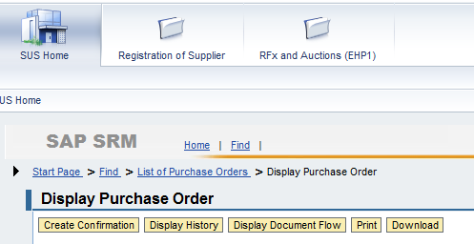
Process Details - Manage SRM Invoice Processing (Display Document Flow)
Supplier is able to view the whole PO document flow.
Click “Display Document Flow”

Slide 44
Process Details - Manage SRM Invoice Processing (Display Document Flow)
Supplier is able to view the whole PO document flow.
Click Goods Receipt to create Invoice for material item

Slide 45
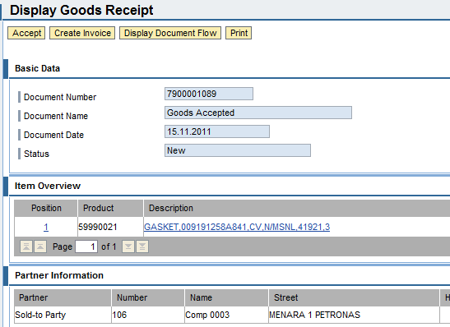
Process Details - Manage SRM Invoice Processing (Material Item)
Invoice Creation for Material.
Click “Accept”
Click “Create Invoice”

Slide 46
Process Details - Manage SRM Invoice Processing (Display Document Flow)
Supplier is able to view the whole PO document flow.
Click Confirmation to create Invoice for services

Slide 47
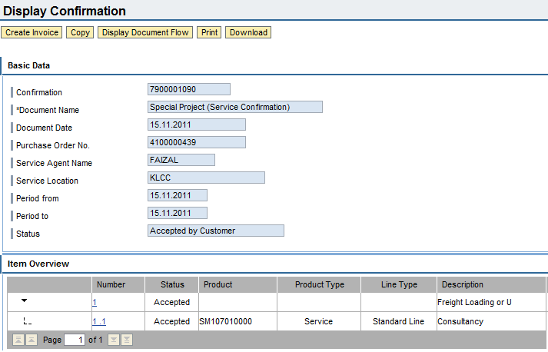
Process Details - Manage SRM Invoice Processing (Service Item)
Invoice Creation for Service
Click “Create Invoice”

Slide 48
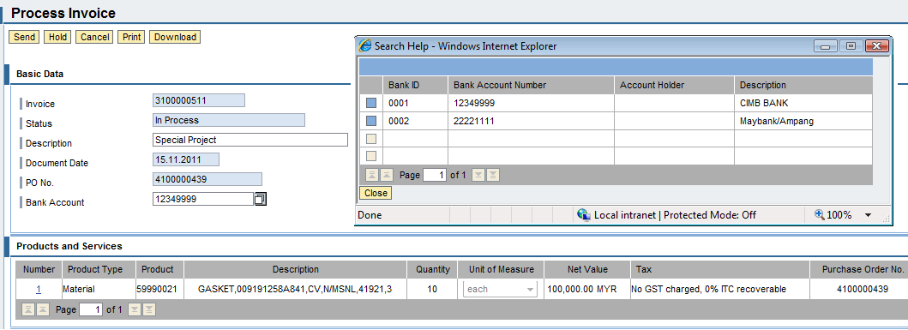
Process Details - Manage SRM Invoice Processing
Select “Bank ID”
Manage Invoice Creation for both Material and Service Items
Select “Bank Account”

Slide 49
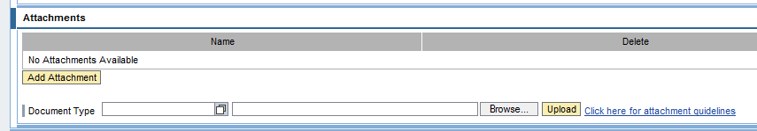
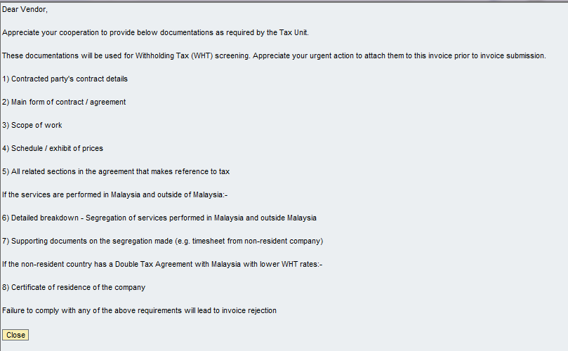
Process Details - Manage SRM Invoice Processing
To upload attachment for CAPS/Finance review
Click to review Attachment guideline

Slide 50
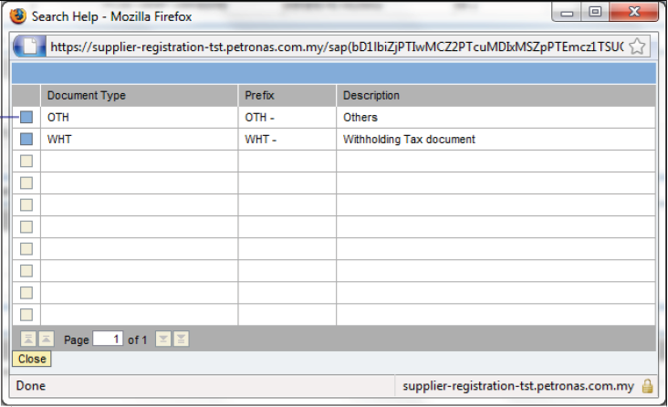
Process Details - Manage SRM Invoice Processing

Slide 51
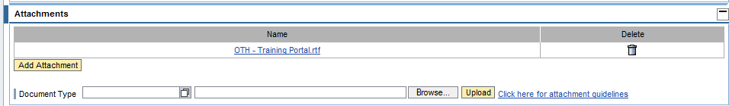
Process Details - Manage SRM Invoice Processing
Click Browse the document to upload file. Select the file and click OK
Click Upload to attach the file onto the invoice

Slide 52
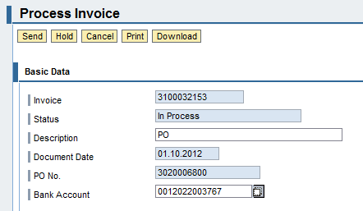
Process Details - Manage SRM Invoice Processing
Click “Send”

Slide 53
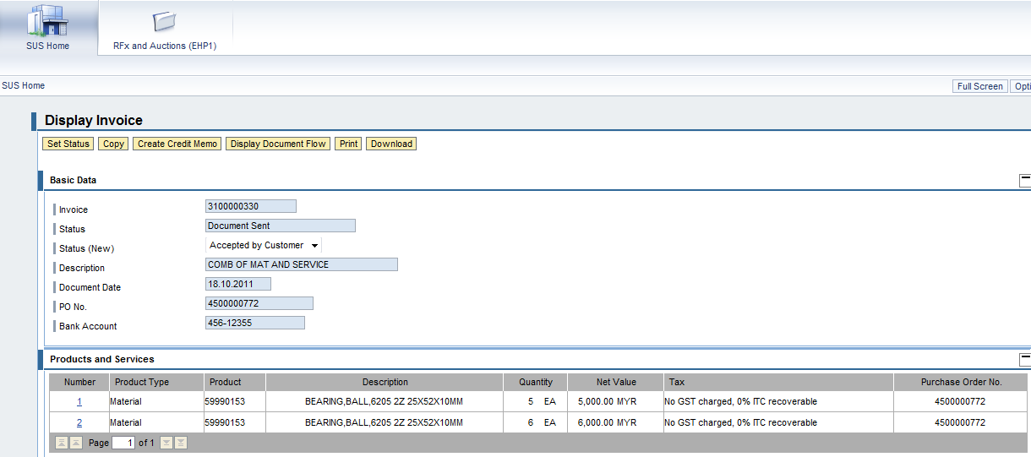
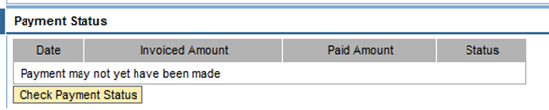
Process Details - Manage SRM Invoice Processing
NOTE: Supplier is required to set the status to “Rejected by Customer” to create a new invoice.
Click “Set Status”
Set Status to “Accepted by Customer”
Click “Check Payment Status”

Slide 54
Course Agenda
Process Overview
Key Changes
Manage Bidder Response for RFQ 1 Tier Evaluation
Manage Bidder Response for RFQ 2 Tier Evaluation
Manage Supplier Collaboration
Manage SRM SUS Purchase Order Confirmation/Acknowledgement
Manage SRM SUS Goods Receipt/Service Confirmation
Manage SRM SUS Invoice Processing
Summary
Appendix

Slide 55
Summary
You have learnt the following:
Manage Bidder Response for RFQ 1 Tier Evaluation
Manage Bidder Response for RFQ 2 Tier Evaluation
Manage Supplier Collaboration
Manage SRM SUS Purchase Order Confirmation/Acknowledgement
Manage SRM SUS Goods Receipt / Service Confirmation
Manage SRM SUS Invoice Processing

Slide 56
Appendix – Email Notification to Supplier
Document Type | Status
RFQ | Publish (Bid Invitation to supplier)
Purchase Order | New
 | Change
Goods Receipt | Goods Receipt/ Ready for Inspection (Movement Type: 103)
 | Goods Accepted (Movement Type: 105)
 | Goods Returned (Movement Type: 124)
 | Goods Cancellation/ Reversal
Invoice | Invoice Rejected
 | Payment has been made

Slide 57
Appendix – Statuses Available for Document Types
Document Type | Document Status
RFQ | Publish
Bid Response / Quotation | Submitted, Accepted, Withdrawn
Purchase Order | New, In Process, Confirmed, Deleted
GRN - Goods Received (Movement Type: 103) | New, Document Read
GRN - Goods Accepted (Movement Type: 105) | New, Document Read
GRN - Goods Returned (Movement Type: 124) | New, Document Read
GRN - Goods Reversed | New, Document Read
Service Confirmation | Completion Reported, Accepted by Customer, Rejected by Customer
Invoice | Document Sent, Accepted by Customer, Rejected by Customer Payment Received

Slide 58
Question and Answer Session
Due to time constraint, we appreciate your attention to
SUS – related questions only

Slide 59
Thank You

